Slide 1
Into the Unknown: MTC Middle School
What to expect this year?

Slide 2
6th Grade Open House Agenda
Grade Level Expectations
ATL’s
Grading Policy
Late and Missing Work
Dress Code
Conduct
Field Trip Eligibility
NJHS
Educator Pages Review
Introduction to OneNote

Slide 3
Grade Level expectations

Slide 4
6th Grade
Trimester 1
Write homework in planner for each class
Learn to access and navigate Educator Pages
Learn and practice One Note and to compose an email to a teacher
Check your personal email at least twice a day
Trimester 2 & 3
Use One Note proficiently
Write an email to a teacher
Approach teachers for any absent or missing work and/or schedule makeup time for missed assessments
Learn to transition from classroom to classroom
Comply to dress code
Organize and pack only needed books during the school day
Prepare for assessments in advance
Learn to organize and pack only needed books and materials during the school day
Arrive to school daily in appropriate uniform dress code

Slide 5
ATL: Approaches to Learning

Slide 6
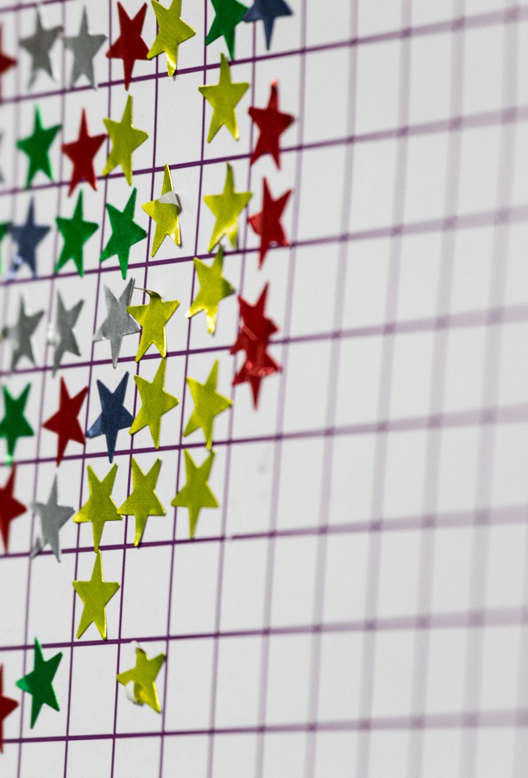
Approaches to learning: (ATL)
The ATL Grade for each class will be:
recorded in RenWeb
details are viewable in RenWeb
You will see the ATL grade listed as a separate category. All students begin the trimester with a grade of 4. If the ATL grade drops, it will be adjusted in the gradebook.
Students receive an ATL grade in each class, including Specials.

Slide 7
APPROACHES TO LEARNING (atl)
The following are the indicators of Organization, Communication/ Collaboration and Reflective Thinking.
Organization
Prepared for class
Punctual with homework and in-class assignments
Completed homework and in-class assignments
Collaboration & Communication
Participates in class
Attentive and engaged during instruction
Demonstrates helpfulness and teamwork
Reflection & Personal Initiative
Open to teacher help and correction
Makes effort to improve behavior/performance by seeking help when needed
Makes time for personal study and improvement

Slide 8
 | Organization | Collaboration & Communication | Reflective Thinking
4 Exceeds (0 to 2 ATLs) | Consistently displays readiness to learn through preparedness, punctuality and task completion. | Consistently attentive and engaged; participates well in class; works well in groups; seeks help when needed. | Consistently open to teacher feedback; reflects on how to keep improving; produces quality work; makes time for personal study and improvement.
3 Meets (3 to 7 ATLs) | Frequently displays readiness to learn through preparedness, punctuality and task completion. | Frequently attentive and engaged; participates well in class; works well in groups; seeks help when needed. | Frequently open to teacher feedback; reflects on how to keep improving; produces quality work; makes time for personal study and improvement.
2 Developing (8 to 13 ATLs) | Occasionally displays readiness to learn through preparedness, punctuality and task completion. | Occasionally attentive and engaged; participates well in class; works well in groups; seeks help when needed. | Occasionally open to teacher feedback; reflects on how to keep improving; produces quality work; makes time for personal study and improvement.
1 Rarely (14+ ATLs) | Rarely displays readiness to learn through preparedness, punctuality and task completion. | Rarely attentive and engaged; participates well in class; works well in groups; seeks help when needed. | Rarely open to teacher feedback; reflects on how to keep improving; produces quality work; makes time for personal study and improvement.

Slide 9
Grading policy

Slide 10
Grading Policy
Summative Assessments 70%
Include test, projects and prolonged writing assignments
Trimester 1 and 3 exams count as one summative assessment each trimester
Formative Assessments 30%
Varies from teacher to teacher but students are informed when an assignment is a formative
Include but are not limited to quizzes, entrance/exit tickets (unannounced) and IXL.
Tests and quizzes will be posted on Educator Pages before the assessment.
There will be no more than 3 tests or quizzes on a day
EX: 2 tests and 1 quiz 1 test and 2 quizzes 3 QUIZZES

Slide 11
Grading Policy
Summative Assessments 70%
Include test, projects and prolonged writing assignments
Trimester 1 and 3 exams count as one summative assessment each trimester
Formative Assessments 30%
Varies from teacher to teacher but students are informed when an assignment is a formative
Include but are not limited to quizzes, entrance/exit tickets (unannounced) and IXL.
Tests and quizzes will be posted on Educator Pages before the assessment.
There will be no more than 3 tests or quizzes on a day
EX: 2 tests and 1 quiz 1 test and 2 quizzes 3 QUIZZES

Slide 12
GRADING POLICY
The lowest earned grade is a 50%.
Assessments not attempted or handed within 3 days of the due date will receive zero points.

Slide 13
LATE WORK
All assignments are to be turned in on the due date. Assigned work is due at the beginning of class.
Late assignments will be accepted up to 3 days following the original due date for a maximum of 50%.
Late summative projects will be accepted up to 3 days following the original due date with a 15-point deduction for each day late.
Students will earn an ATL for each day the work is not submitted. After 3 days, the assignment is no longer accepted.

Slide 14
Middle school dress code
What to wear? What not to wear?

Slide 15
Dress code: boys 6-8
Khaki pants or shorts (no shorter than 2” from mid knee).
Royal or light blue polo shirts, either cotton or performance material, embroidered with the Mother Teresa of Calcutta logo
Shirts must be tucked in.
No long-sleeved shirts may be worn under the polo shirts.
White ankle socks that cover the entire ankle without logos. No-show socks are not to be worn.

Slide 16
Dress Code: girls 6-8
Plaid skirt (no shorter than 2” from mid knee).
Khaki pants or shorts (no shorter than 2” from mid knee).
Royal or light blue polo shirts, either cotton or performance material, embroidered with the Mother Teresa of Calcutta logo.
Shirts must be tucked in.
No long-sleeved shirts may be worn under the polo shirts.
White ankle socks that cover the entire ankle without logos. No knee socks, tights, or no-show socks may be worn.
Girls are allowed to wear navy uniform leggings under their skirts/jumpers on days when the temperature is below 60 degrees.
Hair decorations: Bows, headbands, and scrunchies should be small (less than 3” for bows and 2” for headbands) in royal blue, light blue, white, khaki, navy, or school plaid. Bows, headbands, or ponytail ribbons that have been pre-approved for sale and purchased from the MTC Spirit Store are also acceptable.

Slide 17
Jewelry & Makeup
One thin small chain with one small religious medal or cross (less than 1”).
Earrings – girls only – One pair of small post earrings.
No rings or bracelets.
Small conservative watch which are not audible is allowed. NO SMARTWATCHES ALLOWED!
Make-up, artificial nails, and nail polish are not permitted.

Slide 18
Other apparel expectations
Shoes must be solid black. They should be leather or canvas shoes with black soles that buckle, Velcro, or tie. No slip-on shoes, high tops, or heels
Belt: black leather
½ Zip performance material sweatshirt and/or royal blue fleece jacket with school logo.
All shorts, slacks and skorts should be worn so that they fit at the waist, not rolled at the waist or hanging down around the hips.
No altering of the uniform is allowed other than the adjustment of hem to the appropriate length. The embroidery of initials or names is considered altering the uniform and is not permitted. All name labels must be on the inside of apparel.

Slide 19
Appearance & grooming
BOYS
GIRLS
Hair, when fully extended, must be cut above the eyebrows, above the ears, and above the collar.
Hair should not be cut with less than #2 razor.
No lines cut into hair.
No dyed hair color or artificial highlights.
Fad hairstyles such as spiked hair, shaved areas or any such extreme styles are not permitted.
When applicable, boys should always be clean shaven.
Hairstyles should be conservative and in good taste.
Unnatural hair color is not permitted.
No lines cut into hair.
Make up and nail polish are not permitted.
Fad hairstyles such as spiked hair, shaved areas or any such extreme styles are not permitted..

Slide 20
BEHAVIOR POLICY
OWNERSHIP & ACCOUNTABILITY

Slide 21
CONDUCT EXPECTATIONS
6 DEMERITS
AUTOMATIC DETENTION
1 DEMERIT
3 DEMERITS
Lack of self-control
Tardy to class
Excessive talking classroom/hall
Dress code violation
Chewing gum/eating in class
Not following directions
Out of seat w/out permission
Inappropriate use of technology
Sent out of class for behavior
Disrupting learning of others
Disrespect to property/person
Dishonesty/cheating/copying assignments
Conduct that is un-Christian or contrary to the character of a Catholic School

Slide 22
Conduct expectations
Violation= 1 Demerit
6 Demerits= 1 Detention
1 In School Suspension = 10 Demerits
1 Out of School Suspension = 15 Demerits

Slide 23
Field trip eligibility & incentives
Students who earn a 3 or above in conduct (0 to 7 demerits) are eligible to attend field trips scheduled in the current trimester.

Slide 24
NJHS
Eligibility Requirements
Be enrolled in 7th or 8th grade.
Minimum of all A’s and one B during the first two trimesters of current school year.
Minimum of all 3’s in Conduct and Approaches to Learning during the first two trimesters of current school year.
Application Process
Each candidate will write an essay explaining how he/she demonstrates the qualities of service, leadership, citizenship, and character in addition to completing an application form.
The faculty advisory committee will utilize the following rubric to evaluate each candidate based on academic records, information provided in the essay and completed application form, as well as their knowledge of the student. The advisory committee will then vote on each candidate. Candidate’s receiving 70 % of the votes will be inducted.

Slide 25
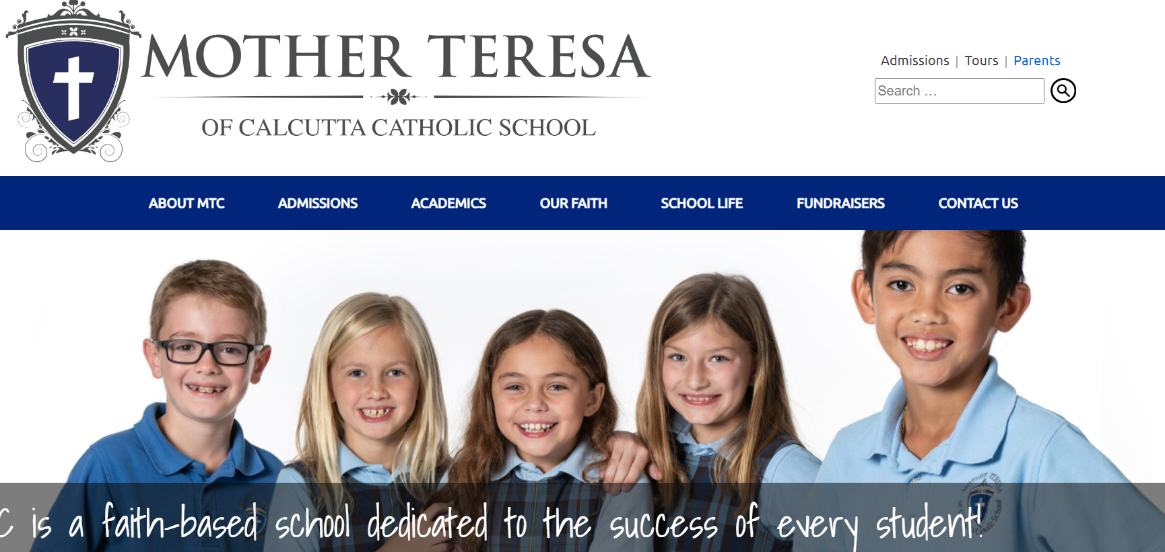
Educator Pages
Access Educator Pages through School Website mtctampa.org
Select Parents Tab Then Continue to Educator Pages: Sixth

Slide 26
Educator Pages
Select the Sixth Grade Tab

Slide 27
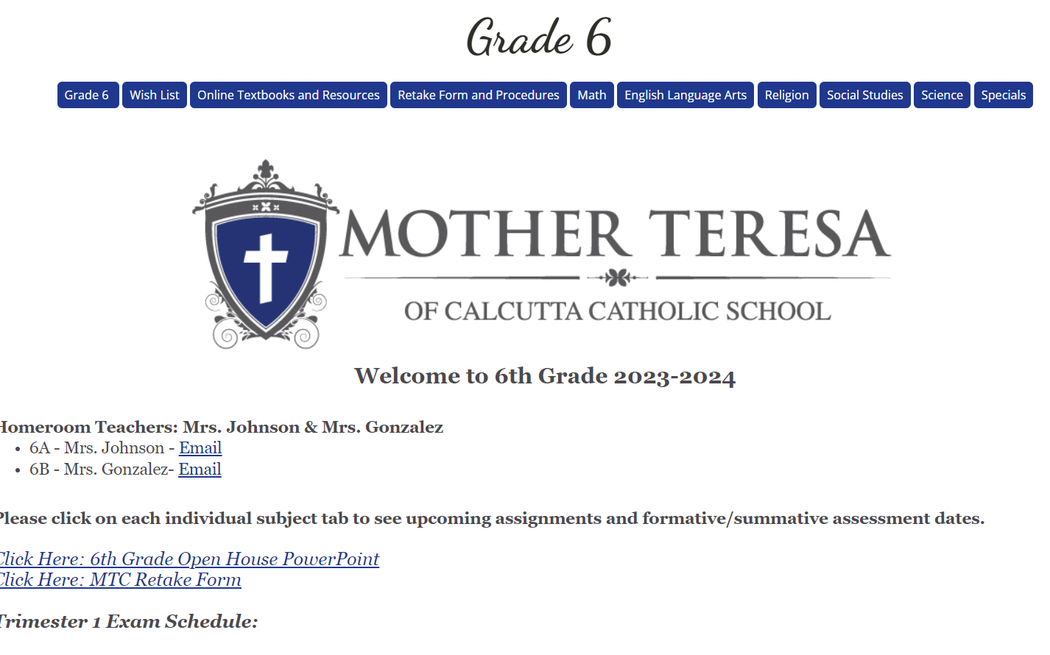
Educator Pages
Select the class you want to view

Slide 28
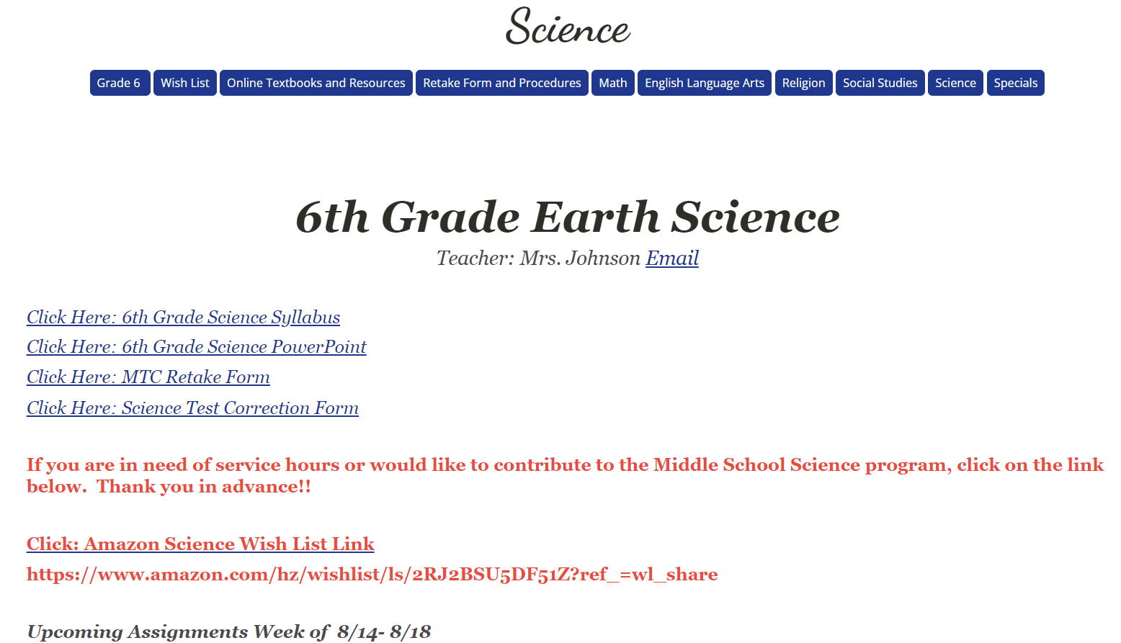
Educator Pages
You can click to view any of the attached documents
You will be able to view all Homework, upcoming assignments, formative and summative assessments
Teachers may make changes to Assignments throughout the week which will be noted in the student planner

Slide 29
Educator Pages
You can click to view any of the attached documents
You will be able to view all Homework, upcoming assignments, formative and summative assessments
Teachers may make changes to Assignments throughout the week which will be noted in the student planner

Slide 30
OneNote
Students will use OneNote for most classes
Teacher will post assignments in OneNote either in Content Library or Student Folders
All work done in OneNote is automatically saved and the teacher can view the assignment and the work completed by the student
Teachers may lock an assignment, once due, so no further edits may be made.

Slide 31
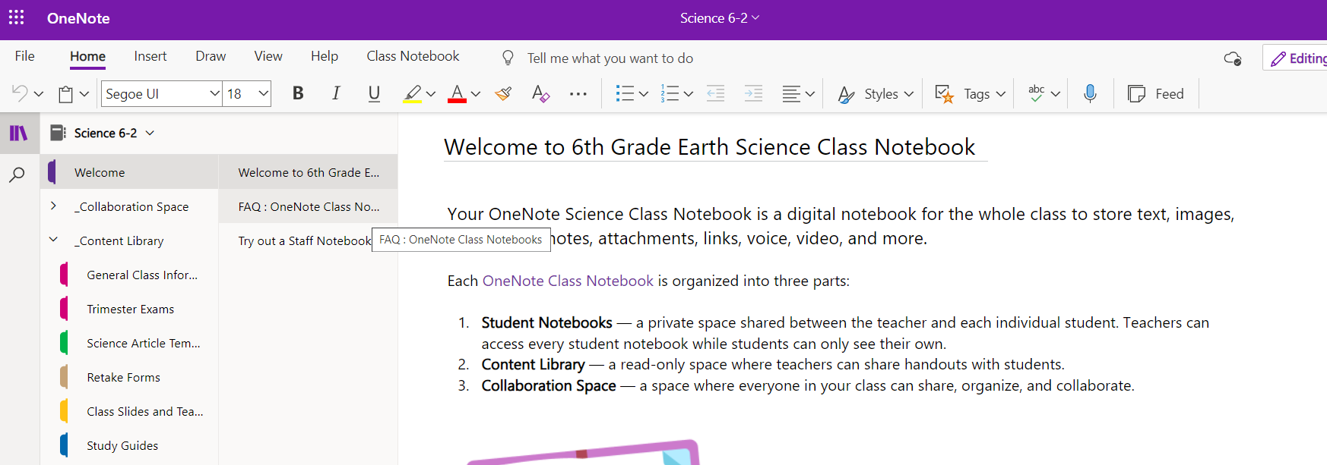
OneNote
Students will use OneNote for most classes
Teacher will post assignments in OneNote either in Content Library or Student Folders
All work done in OneNote is automatically saved and the teacher can view the assignment and the work completed by the student
Teachers may lock an assignment, once due, so no further edits may be made.

Slide 32
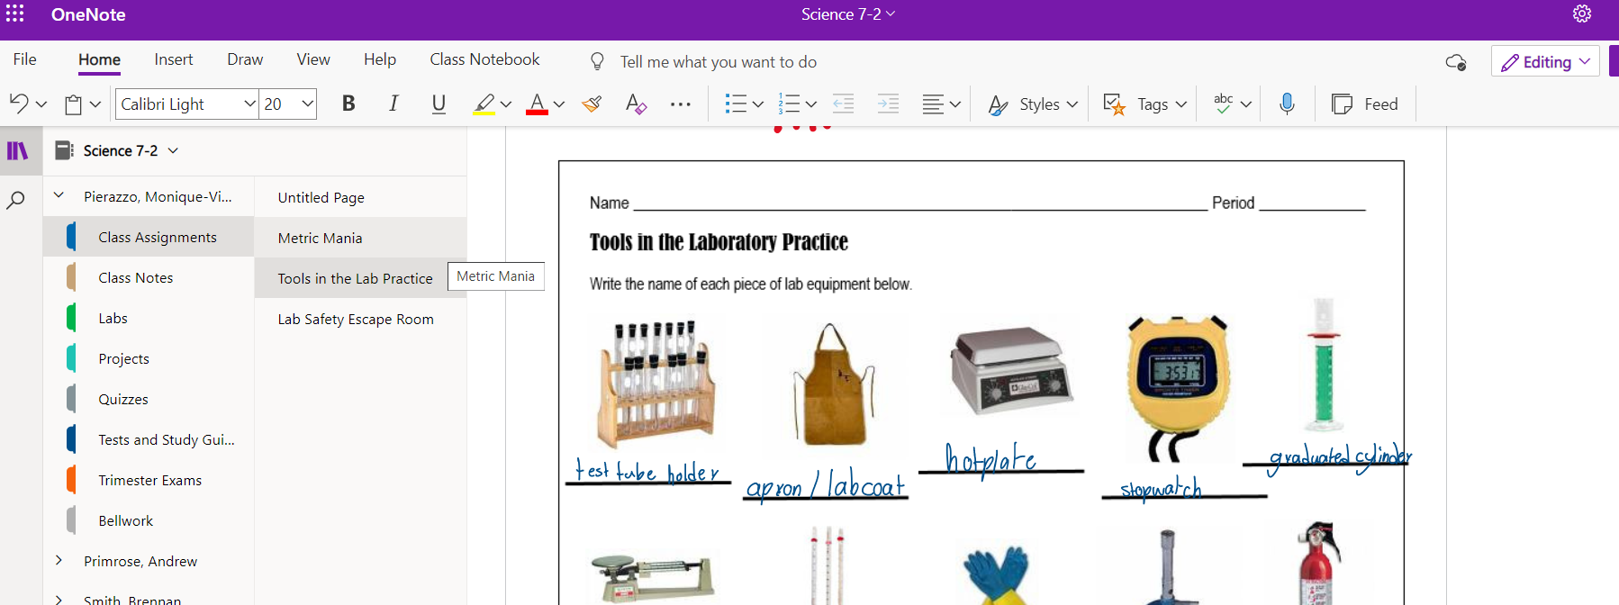
OneNote
Students will use OneNote for most classes
Teacher will post assignments in OneNote either in Content Library or Student Folders
All work done in OneNote is automatically saved and the teacher can view the assignment and the work completed by the student
Teachers may lock an assignment, once due, so no further edits may be made.

Slide 33
Thank You!
Please contact Mrs. Johnson or Mrs. Gonzalez for any further questions
Mrs. Johnson (6A) ajohnson@mtctampa.org
Mrs. Gonzalez (6B) lgonzalez@mtctampa.org

